Slide 1
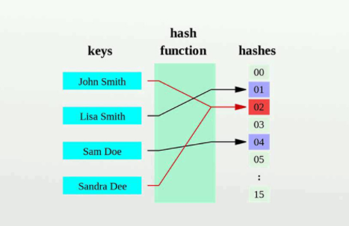
Collision

Slide 2
Collision Hashing:
If x1 and x2 are two different keys, it is possible that h(x1) = h(x2).
=> called a collision Hashing
Collision resolution is the most important issue in hash table implementations.
Choosing a hash function that minimizes the number of collisions and also hashes uniformly is another critical issue:
Separate chaining (open hashing)
Linear probing
Quadratic Probing
Double hashing
`

Slide 3
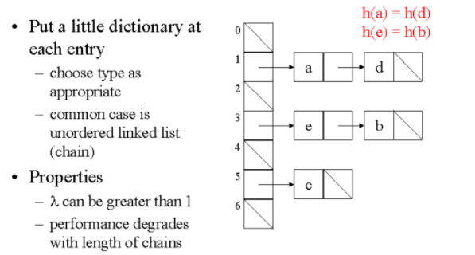
Separate chaining (open hashing)
-The idea is to make each cell of hash table point o a linked list of records that have same hash function value.

Slide 4
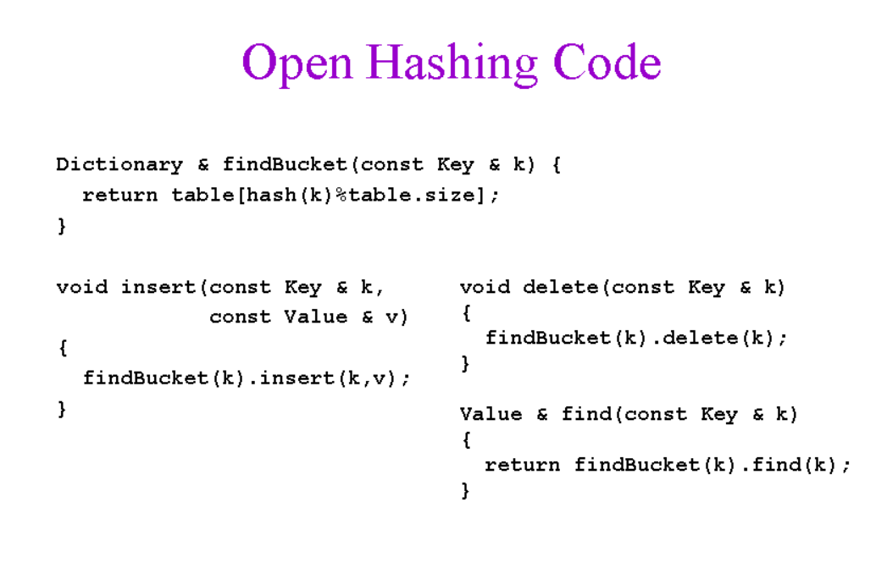

Slide 5
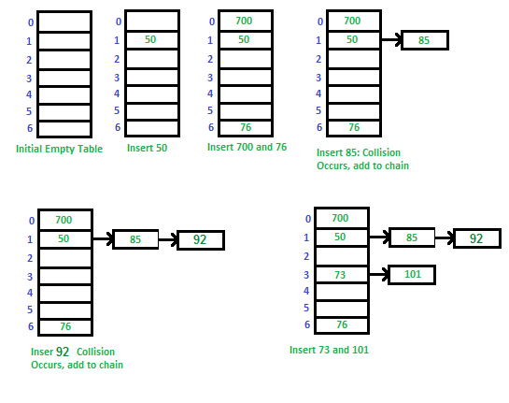
Let's say we have a hash function that converts the keys 50, 700, 76, 85, 92, 73, 101 by dividing by 7 and then taking the remainder.

Slide 6
Advantages and Disadvantages
Advantages:
-Simple installation
-Don't worry about the size of the hash table
-You can always add data to the table by adding linked lists
Disadvantages:
-Sometimes memory is wasted
-time spent on searching and removing elements can be very time consuming.
More memory is required for linked list elements.

Slide 7
Linear Probing
If the slot at the hashed index is unoccupied, then the entry record is inserted in slot at the hashed index else it proceeds in some probe sequence until it finds an unoccupied slot.
The interval between slots is computed by adding the successive value of an arbitrary polynomial in the original hashed index:
-The main advantage of linear search is it’s simplicity, make it the least cache burden.
-It’s search for empty index can take a long time.
-It can cause clustering at the bottom of the table.

Slide 8
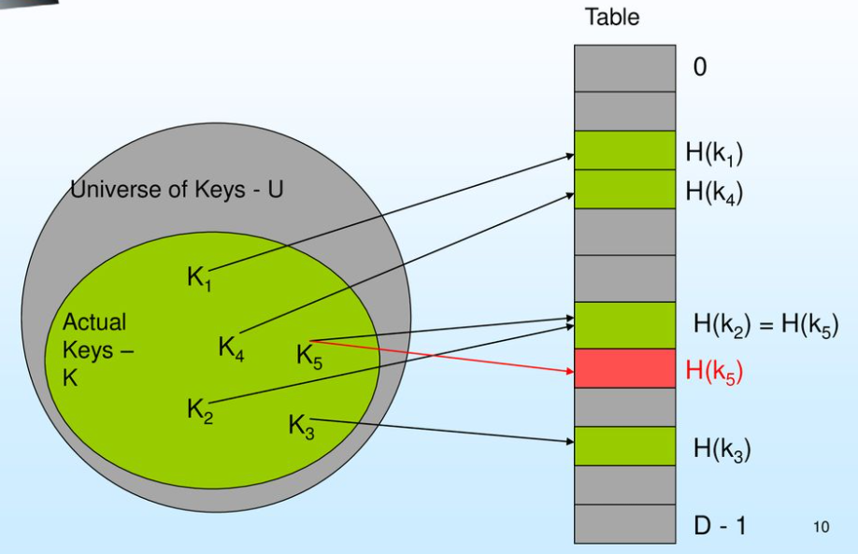

Slide 9
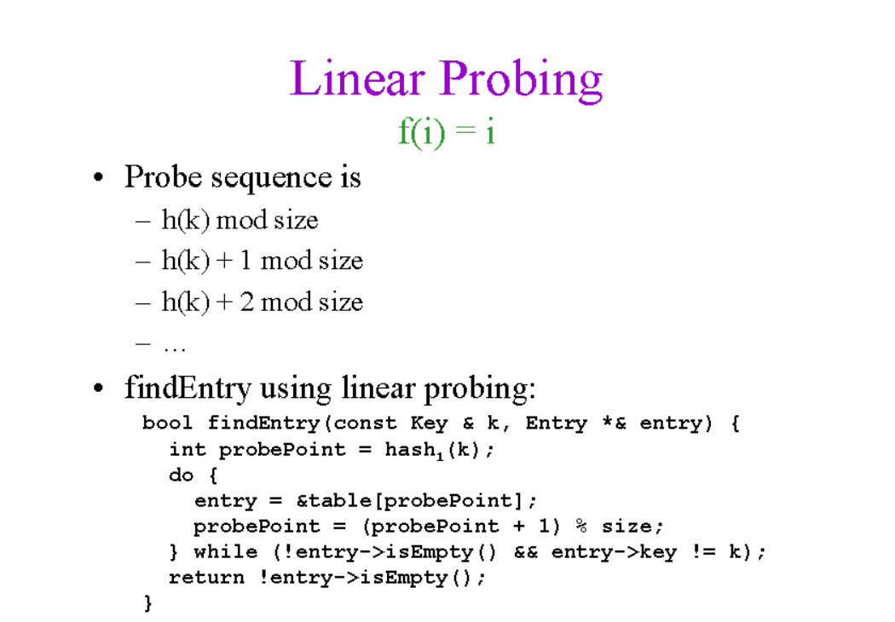

Slide 10
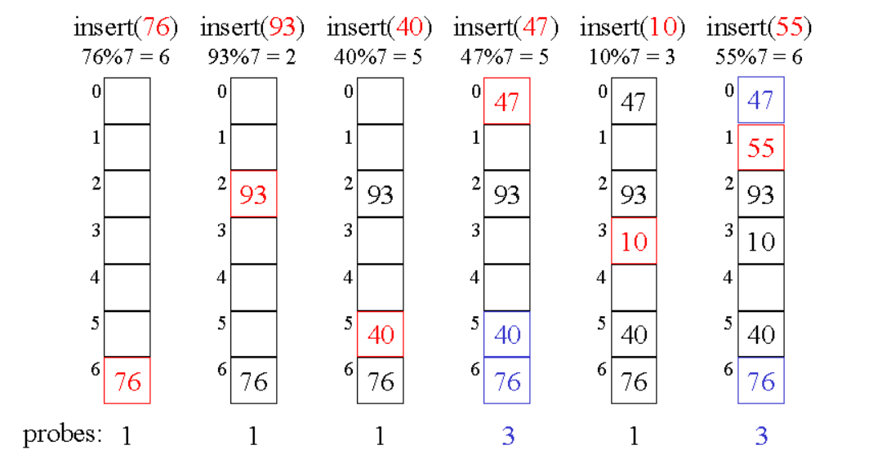
Let's say we have a hash function that converts the keys 76, 93, 40, 47, 10, 55 by dividing by 7 and then taking the remainder.

Slide 11

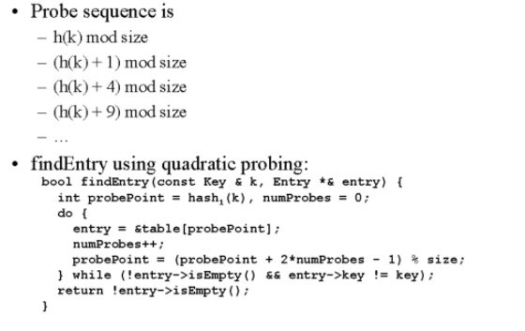
• Quadratic probing is similar to linear probing and the only difference is the interval between successive probes or entry slots.

Slide 12
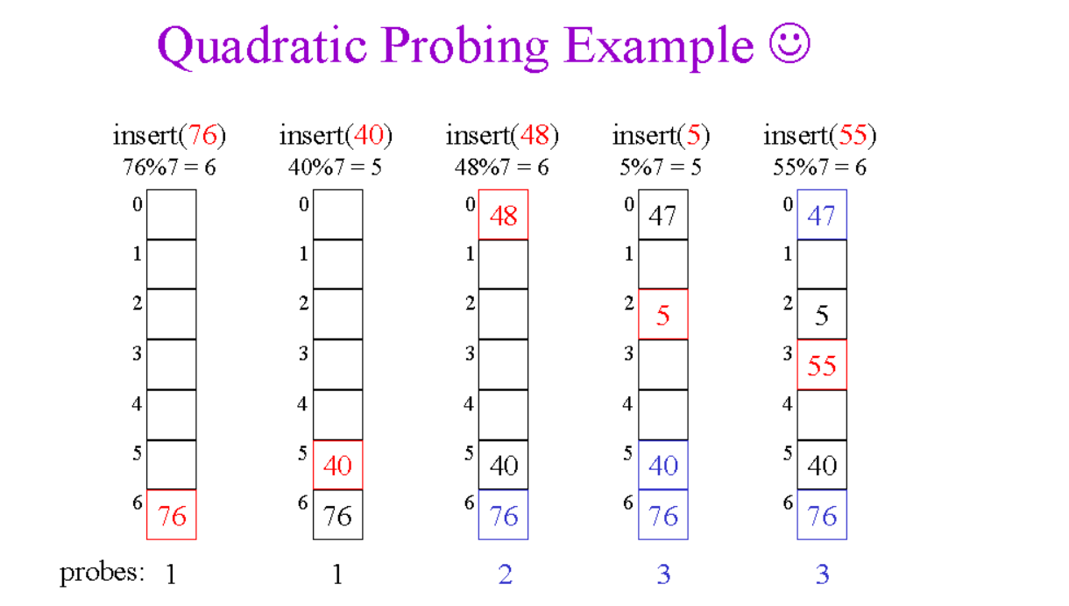

Slide 13
Double Hashing
• Double hashing is similar to linear probing and the only difference is the interval between successive probes. Here, the interval between probes is computed by using two hash functions.
The probing sequence will be:
index = (index + 1 * indexH) % hashTableSize;
index = (index + 2 * indexH) % hashTableSize;

Slide 14
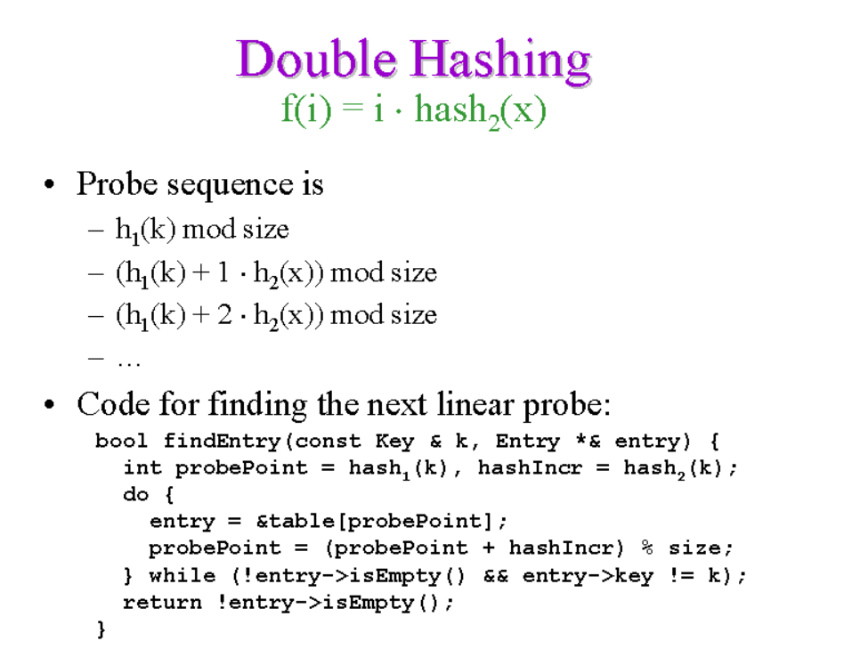

Slide 15
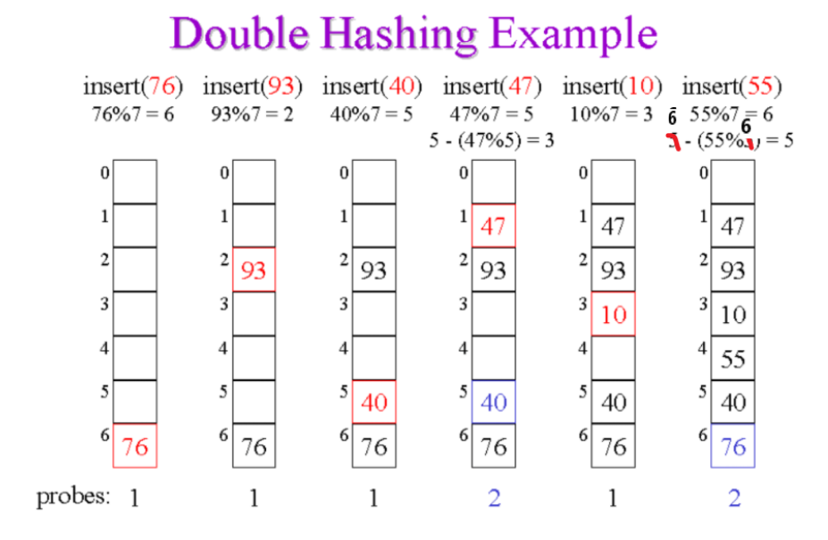

Slide 16
